Slide 1
Unpacking Unconscious Bias
Introduction and
Pre-Course Reading

Slide 2
Agenda
Course Learning Objectives
Terms of Engagement
Course Overview
How to Navigate in WebEx

Slide 3
Course Learning Objectives
After completing this course, you will be able to:
understand what biases are and recognize the multiple forms of biases
be more aware of and think about the consequences of unconscious biases in the workplace for those involved, including yourself
understand and use tools, tips and strategies to better acknowledge and mitigate unconscious bias

Slide 4
How we want to learn, interact and connect
Listen attentively
Be open-minded
Remain respectful and civil even when we disagree
Ask questions and challenge our own assumptions
Respect the confidentiality of information shared by our colleagues (the Vegas rule)
Embark on a journey of self-reflection and learning

Slide 5
What this course does and does not offer
This course DOES… | This course DOES NOT…
Strengthen awareness around unconscious bias | Address harassment and violence in the workplace
Encourage ongoing self-reflection | Discuss racism and discrimination
Provide a platform for participants to engage in a personal learning journey | Provide strategies to help combat racism and discrimination in the workplace
Create a safe space for participants to discuss unconscious bias and systemic barriers | Provide an in-depth explanation on removing systemic barriers within the Government of Canada workplace

Slide 6
Course Overview
Day 1: Introduction
Live Session
Welcome and introductions
Pre-reading debrief
Faces of diversity
Personal reflection exercises
Implicit Attitude Test
Micro-aggression video
Learning journal
Day 2: All About Biases
Live Session
Pre-reading debrief
Biases (what they are, where they come from, and who has them)
Workplace bias
Personal reflection exercises
Vocabulary activity
Learning journal
Day 3: Strategies and Tools to Mitigate Biases
Live Session
Discussion of points of view
Inclusive leader continuum
Strategies and tips to identify and manage unconscious bias
Personal reflection exercises
Facing your own biases
Video
Learning journal
Day 4: Reinforcing Your Learning
Live Session
Recognizing others’ biases
Systemic barriers
Moving from recognizing bias to mitigating bias
Questions and concluding remarks

Slide 7
How to Navigate WebEx
Notes:
Before your course begins, please familiarize yourself with WebEx’s virtual classroom tools.

Slide 8








Overview of Buttons
Mute
Mute
Video
Video
Interaction
Interaction
You can be
heard
You can’t be
heard
You can be
seen
You can’t be
seen
See all
participants
Open the
chat
Raise Your Hand
Yes/Agree
No/Disagree
Slow Down
Speed Up
/Move On
Emoji Reaction

Slide 9
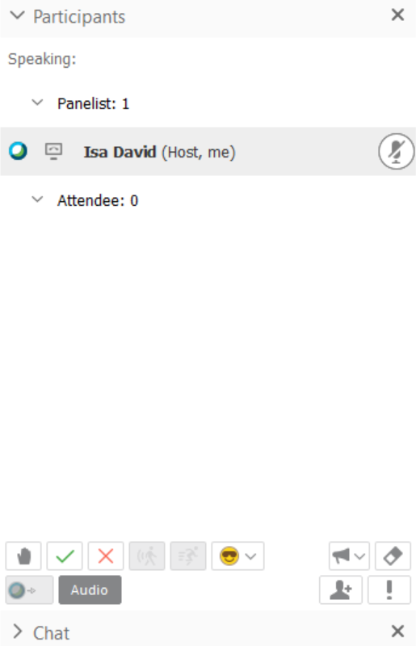
Mute and unmute (phone and computer audio)
Find your name in the participant panel
Click on the microphone icon to the right of your name
If you’ve called in, follow the steps above
(no need to press *6 to mute your mic)
Mute
Mute
You can be
heard
You can’t be
heard

Slide 10
Chat with Others
Use the chat panel to interact with the course facilitator and other learners.

Slide 11
Ask a Question
In the participant panel, raise your virtual hand if you’d like to unmute and ask a question or share a comment.

Slide 12
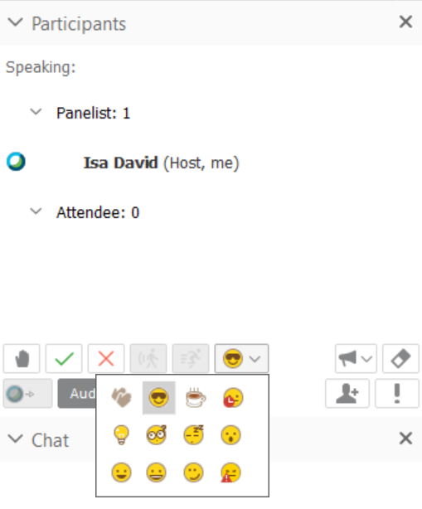
Set a Status
Select the clapping emoji to show your support.
Select the coffee mug emoji if you need to step away or while we’re on break.
Select any of the other emojis to express how you’re feeling.

Slide 13
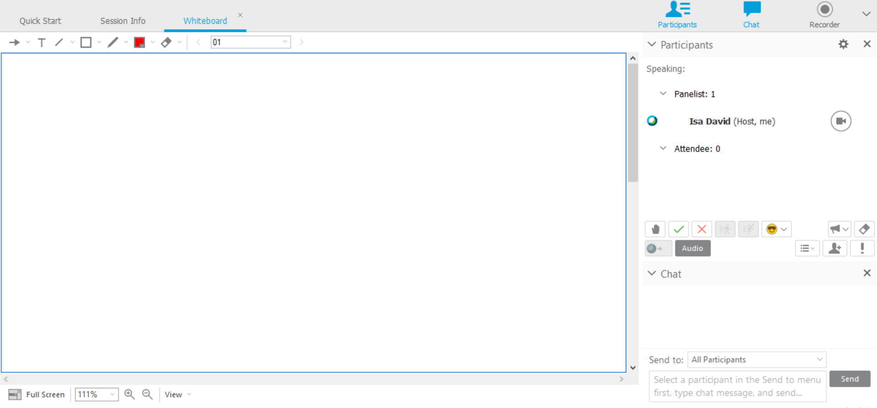


Whiteboard Annotation Tools
Use the annotation tools at the top left of your screen to interact with the slide or whiteboard:
^
Place an arrow with
your name
Write on the
screen
Place lines on
the screen
Place shapes
on the screen
Change colours
Draw on the
screen
Erase

Slide 14

Annotation Tools: Writing on the Screen
Click on the Edit menu at the top of the application
Click on Font
Set Font size to 26 point

Slide 15
If you have any technical difficulties during the session, send a private chat message to the session host at any time.
Enjoy your session!

